Slide 1
Vague Quantifiers
with vision and language
Hugh Mee Wong, supervised by Albert Gatt and Rick Nouwen
a work in progress

Slide 2
Vague quantifiers
A few
A lot
How do we decide where to "draw the line"?
When do we decide to use which vague quantifier?
there are few people at the party vs there are a few people at the party
there are many people at the party vs there are a lot of people at the party
there are some people at the party

Slide 3

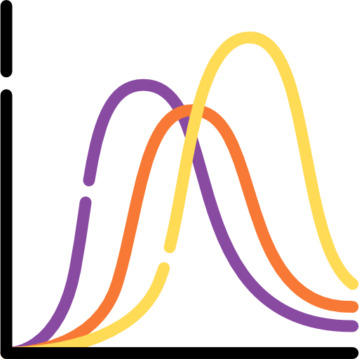


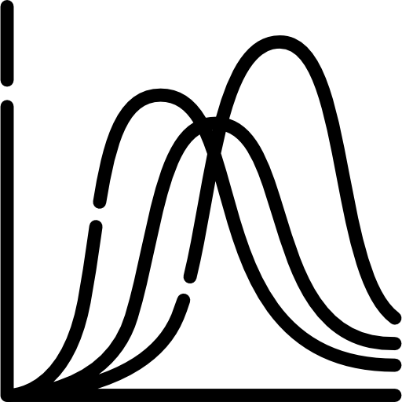
(humans)
Me
Model study
(VL models)

Slide 4


General setup
probability
"a few"
"many"
x-axis = ?
image-text match score
a lot of people 0.8
some people 0.3
a few people 0.1
..
"people"
"a few people"
"some people"
"a lot of people"
"few people"
"many people"
argmax over quants
"a lot of people"
Models tested: ALBEF, FLAVA, BLIP, BLIP-2, LXMERT

Slide 5
Prompt Templates
[QUANT] [OBJECT]
an image of [QUANT] [OBJECT]
THERE ARE [QUANT] [OBJECT] IN THE IMAGE
people
a few people
few people
some people
a lot of people
many people
an image of people
an image of a few people
an image of few people
an image of some people
an image of a lot of people
an image of many people
there are people in the image
there are a few people in the image
there are few people in the image
there are some people in the image
there are a lot of people in the image
there are many people in the image

Slide 6
FSC-147 dataset
Few-shot counting: 147 object classes across 6146 images
Object counts 7 to 3701(but gets very sparse after 100)
Unbalanced w.r.t. object classes
+ TallyQA datasets for counts 1-15
Ranjan, V., Sharma, U., Nguyen, T., & Hoai, M. (2021). Learning to count everything. In Proceedings of the IEEE/CVF Conference on Computer Vision and Pattern Recognition (pp. 3394-3403).

Slide 7
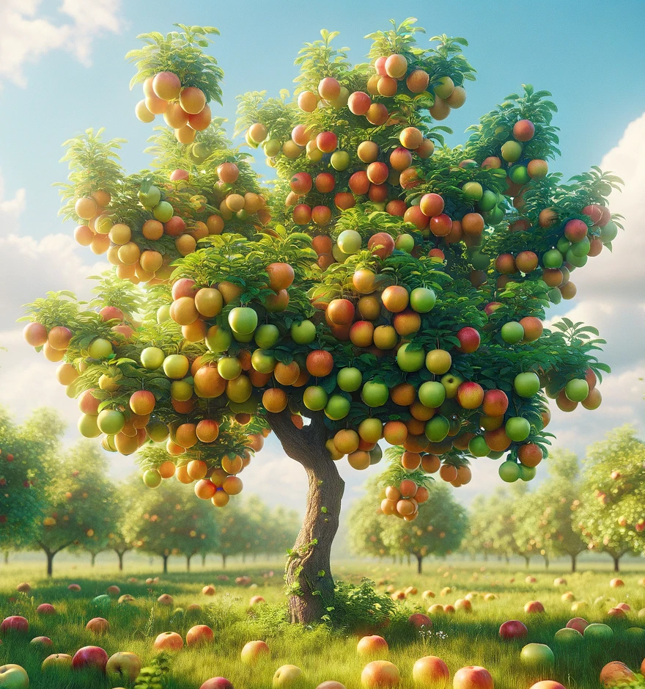
Surface-level heuristics
(Low-hanging fruits)
We study the effects of
segmentation area
object class and norms
object count
image background
on LXMERT, FLAVA, ALBEF, BLIP, BLIP-2

Slide 8
The story of BLIP-2
Li, J., Li, D., Savarese, S., & Hoi, S. (2023, July). Blip-2: Bootstrapping language-image pre-training with frozen image encoders and large language models. In International conference on machine learning (pp. 19730-19742). PMLR.

Slide 9
General setup
probability (ITM score)
"a few"
"many"
x-axis = ?
an image of people
an image of a few people
an image of many people
image-text match score
a lot of people 0.8
some people 0.3
a few people 0.1
z
z
z
z
z
z
baseline = unquantified

Slide 10
OBject Count

Slide 11
OBject Count
1-10: quants ≤ baseline

Slide 12
OBject Count
10+: more "layered"
many $≈$ a lot of
some $≈$ baseline
few $≠$ a few

Slide 13
OBject Count
10+: more "layered"
many $≈$ a lot of
some $≈$ baseline
few $≠$ a few
[0, 5), [5, 10), ...

Slide 14
OBject Count
10+: more "layered"
many $≈$ a lot of
some $≈$ baseline
few $≠$ a few

Slide 15
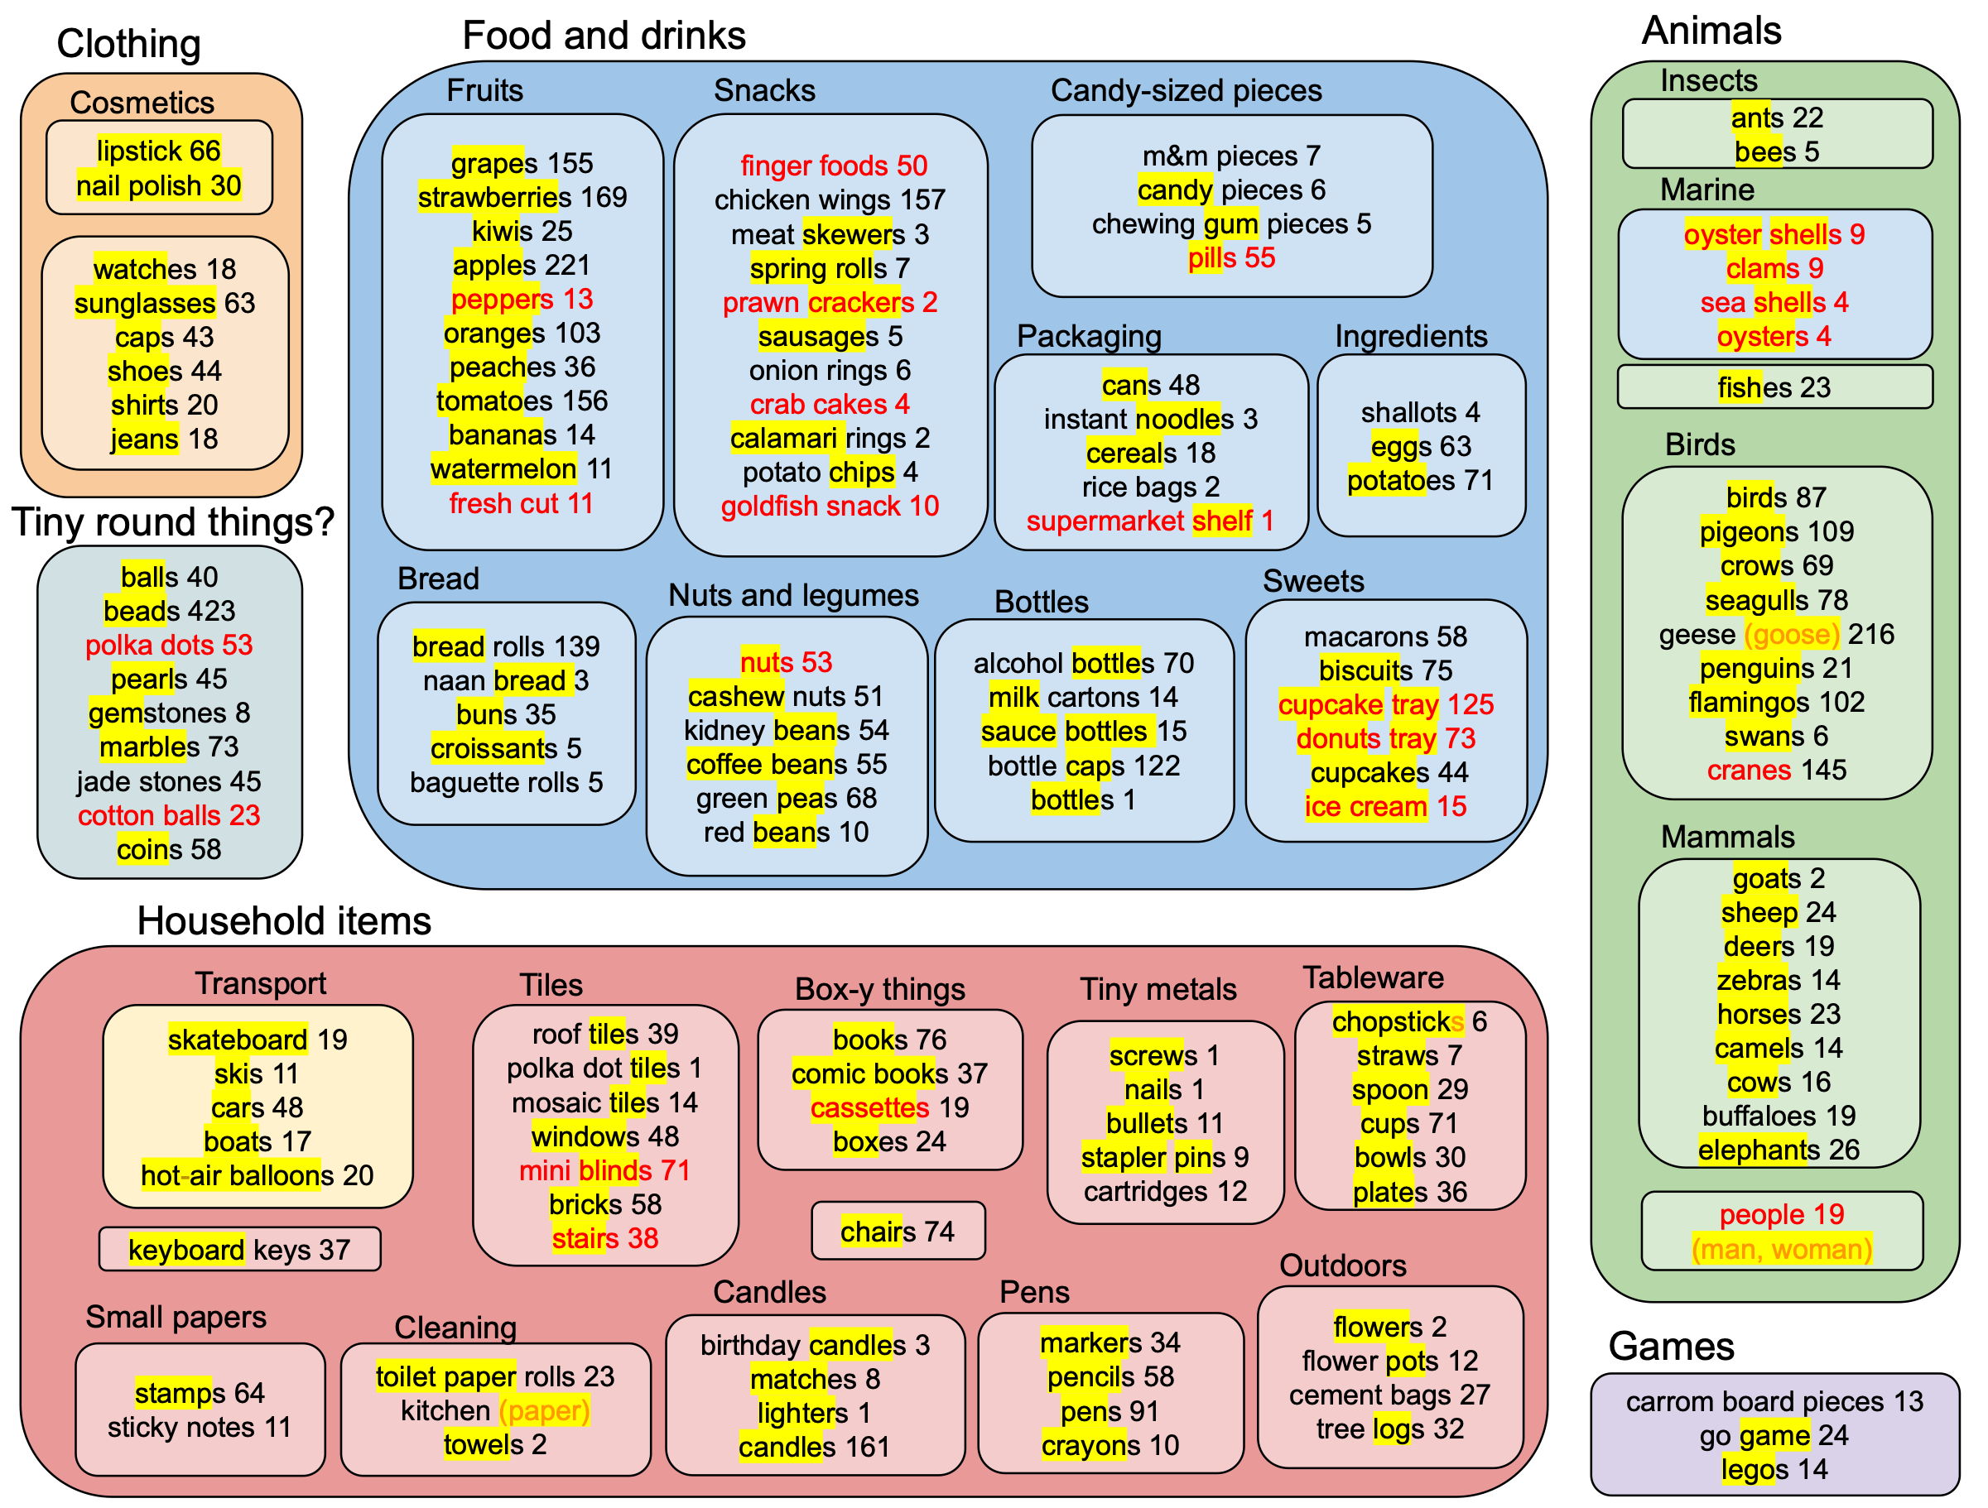
Object count + category + Norm

Slide 16
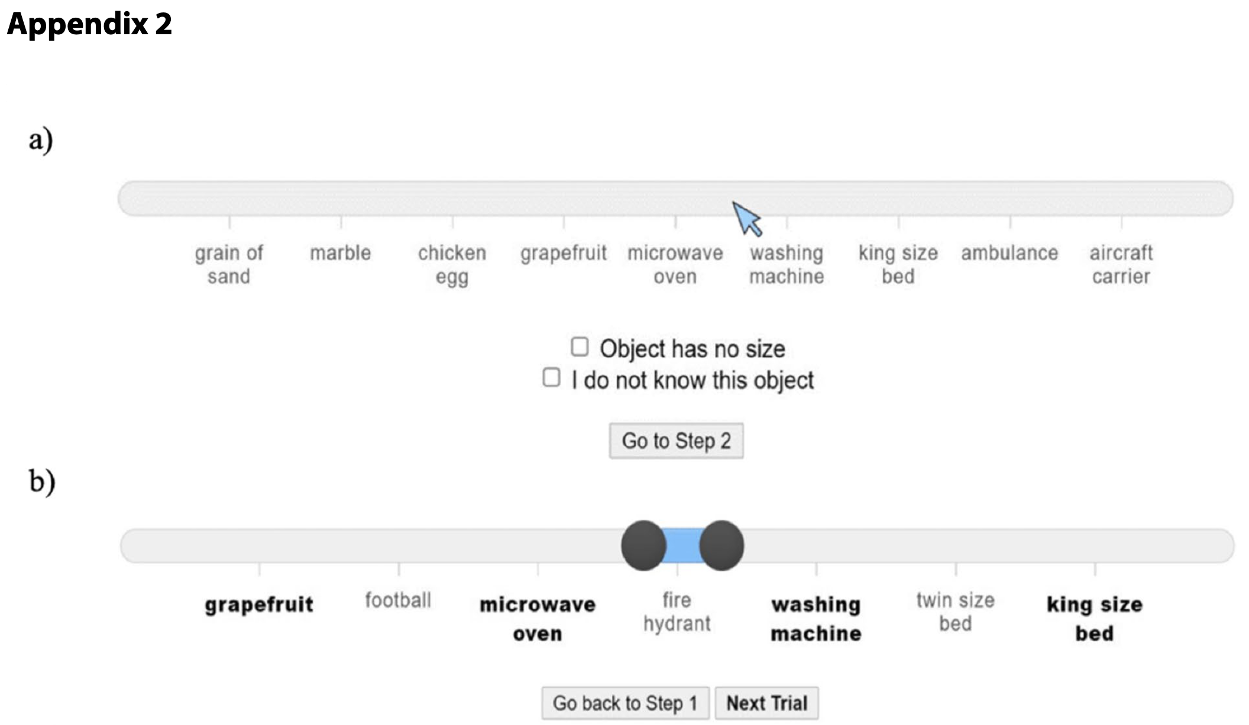
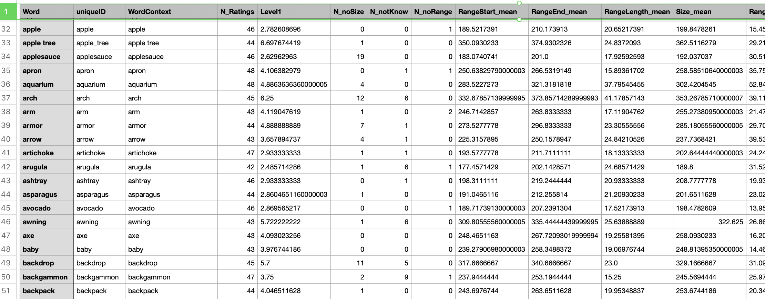
Size Norms: THINGSplus
What is the size of an apple?
Stoinski, L. M., Perkuhn, J., & Hebart, M. N. (2024). THINGSplus: New norms and metadata for the THINGS database of 1854 object concepts and 26,107 natural object images. Behavior research methods, 56(3), 1583–1603. https://doi.org/10.3758/s13428-023-02110-8

Slide 17

Segmentation area
ratio 0.12
"people"
VL probability
CLIPSeg
ratio 0.97
CLIPSeg ratio or area

Slide 18
Segmentation
Count x segmentation?

Slide 19
Human study
(humans)
Me
Model study
(VL models)

Slide 20
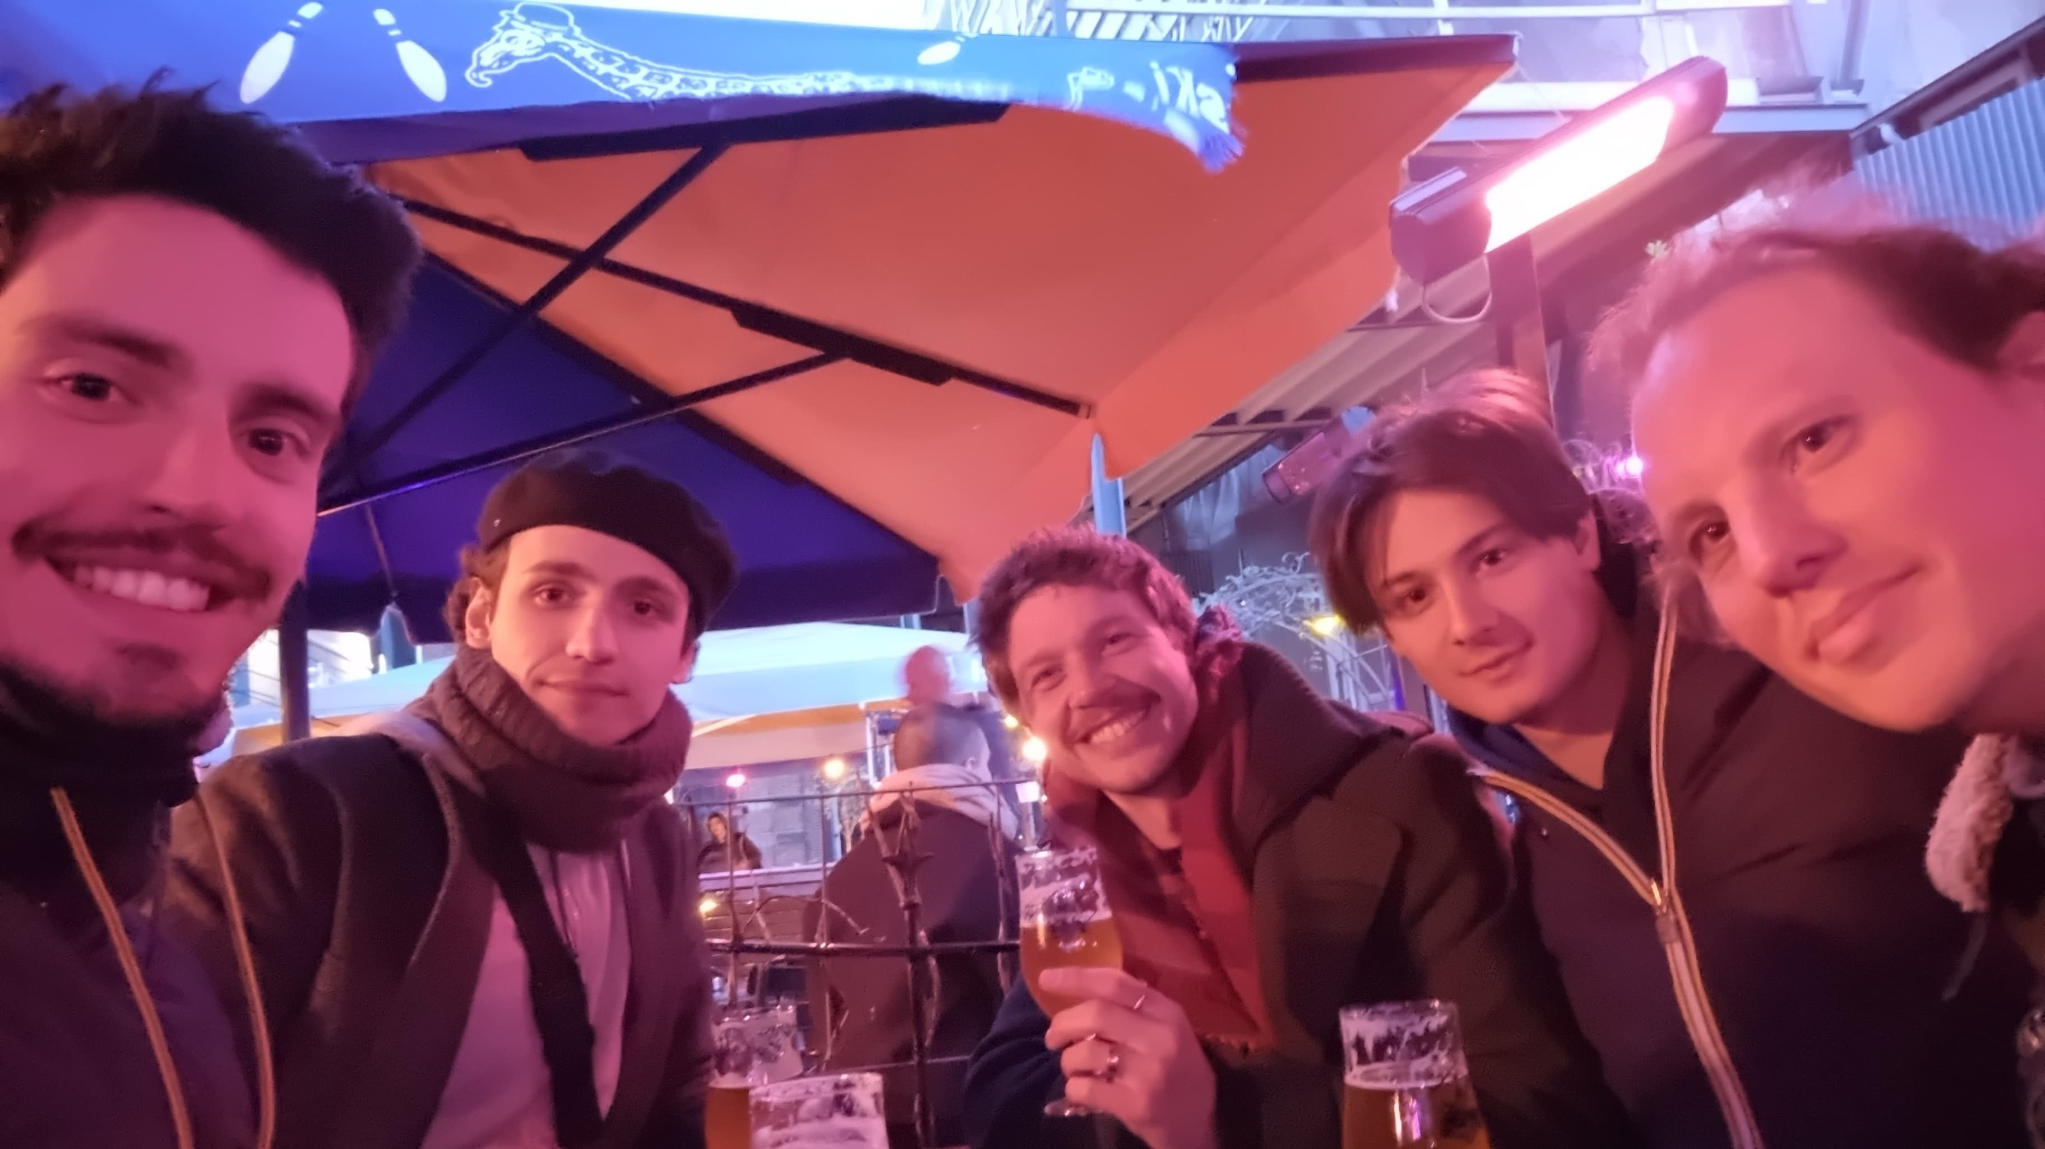
Human Study
An image of a lot of people
Disagree / No / Wrong / ...
Agree / Yes / Correct / ...

